Slide 1
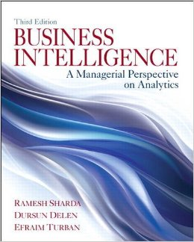
Business Intelligence: A Managerial Perspective on Analytics (3rd Edition)
Chapter 6:
Big Data and Analytics

Slide 2
Big Data - Definition and Concepts
Big Data means different things to people with different backgrounds and interests
Traditionally, “Big Data” = massive volumes of data
E.g., volume of data at CERN, NASA, Google, …
Where does the Big Data come from?
Everywhere! Web logs, RFID, GPS systems, sensor networks, social networks, Internet-based text documents, Internet search indexes, detail call records, astronomy, atmospheric science, biology, genomics, nuclear physics, biochemical experiments, medical records, scientific research, military surveillance, multimedia archives, …

Slide 3
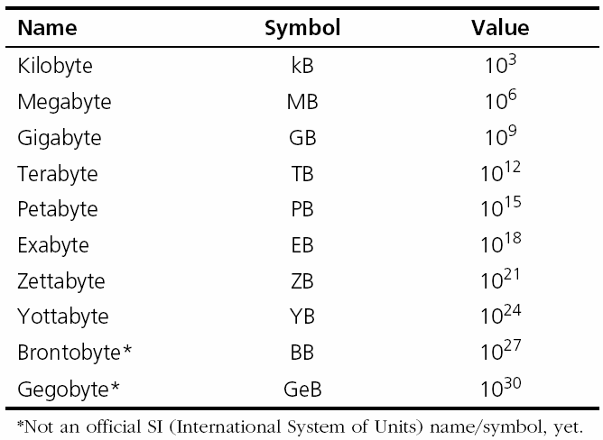
Technology Insights 6.1 The Data Size Is Getting Big, Bigger, …
Hadron Collider - 1 PB/sec
Boeing jet - 20 TB/hr
Facebook - 500 TB/day
YouTube – 1 TB/4 min
The proposed Square Kilometer Array telescope (the world’s proposed biggest telescope) – 1 EB/day

Slide 4
Big Data - Definition and Concepts
Big Data is a misnomer!
Big Data is more than just “big”
The Vs that define Big Data
Volume
Variety
Velocity
Veracity
Variability
Value
…

Slide 5
Fundamentals of Big Data Analytics
Big Data by itself, regardless of the size, type, or speed, is worthless
Big Data + “big” analytics = value
With the value proposition, Big Data also brought about big challenges
Effectively and efficiently capturing, storing, and analyzing Big Data
New breed of technologies needed (developed or purchased or hired or outsourced …)

Slide 6
Big Data Considerations
You can’t process the amount of data that you want to because of the limitations of your current platform.
You can’t include new/contemporary data sources (e.g., social media, RFID, Sensory, Web, GPS, textual data) because it does not comply with the data storage schema
You need to (or want to) integrate data as quickly as possible to be current on your analysis.
You want to work with a schema-on-demand data storage paradigm because of the variety of data types involved.
The data is arriving so fast at your organization’s doorstep that your traditional analytics platform cannot handle it.
…

Slide 7
Critical Success Factors for Big Data Analytics
A clear business need (alignment with the vision and the strategy)
Strong, committed sponsorship (executive champion)
Alignment between the business and IT strategy
A fact-based decision-making culture
A strong data infrastructure
The right analytics tools
Right people with right skills

Slide 8
Enablers of Big Data Analytics
In-memory analytics
Storing and processing the complete data set in RAM
In-database analytics
Placing analytic procedures close to where data is stored
Grid computing & MPP
Use of many machines and processors in parallel (MPP - massively parallel processing)
Appliances
Combining hardware, software, and storage in a single unit for performance and scalability

Slide 9
Challenges of Big Data Analytics
Data volume
The ability to capture, store, and process the huge volume of data in a timely manner
Data integration
The ability to combine data quickly and at reasonable cost
Processing capabilities
The ability to process the data quickly, as it is captured (i.e., stream analytics)
Data governance (… security, privacy, access)
Skill availability (… data scientist)
Solution cost (ROI)

Slide 10
Business Problems Addressed by Big Data Analytics
Process efficiency and cost reduction
Brand management
Revenue maximization, cross-selling/up-selling
Enhanced customer experience
Churn identification, customer recruiting
Improved customer service
Identifying new products and market opportunities
Risk management
Regulatory compliance
Enhanced security capabilities
…

Slide 11
Big Data Technologies
Hadoop -framework that allows for the distributed processing of large data sets across clusters of computers
MapReduce - software framework for writing applications which process vast amounts of data
Hive - data warehouse software facilitating querying and management of large datasets
Pig - platform for analyzing large data sets
Hbase - an open-source, distributed, versioned, non-relational database
Flume - collection, aggregation, and movement of large amounts of log data
Ambari – managing and monitoring Hadoop clusters
Sqoop - transferring bulk data between Hadoop and structured datastores

Slide 12

Big Data Technologies Hadoop
Hadoop is an open source framework for storing and analyzing massive amounts of distributed, unstructured data
Originally created by Doug Cutting at Yahoo!
Hadoop clusters run on inexpensive commodity hardware so projects can scale-out inexpensively
Hadoop is now part of Apache Software Foundation
Open source - hundreds of contributors continuously improve the core technology
MapReduce + Hadoop = Big Data core technology

Slide 13
Big Data Technologies MapReduce
MapReduce distributes the processing of very large multi-structured data files across a large cluster of ordinary machines/processors
Goal - achieving high performance with “simple” computers
Developed and popularized by Google
Good at processing and analyzing large volumes of multi-structured data in a timely manner
Example tasks: indexing the Web for search, graph analysis, text analysis, machine learning, …

Slide 14
Big Data Technologies Hadoop
How Does Hadoop Work?
Access unstructured and semi-structured data (e.g., log files, social media feeds, other data sources)
Break the data up into “parts,” which are then loaded into a file system made up of multiple nodes running on commodity hardware using HDFS
Each “part” is replicated multiple times and loaded into the file system for replication and failsafe processing
A node acts as the Facilitator and another as Job Tracker
Jobs are distributed to the clients, and once completed, the results are collected and aggregated using MapReduce

Slide 15
Big Data Technologies Hadoop
Hadoop Technical Components
Hadoop Distributed File System (HDFS)
Name Node (primary facilitator)
Secondary Node (backup to Name Node)
Job Tracker
Slave Nodes (the grunts of any Hadoop cluster)
Additionally, Hadoop ecosystem is made up of a number of complementary sub-projects: NoSQL (Cassandra, Hbase), DW (Hive), …
NoSQL = not only SQL

Slide 16
Big Data Technologies Hadoop - Demystifying Facts
Hadoop consists of multiple products
Hadoop is open source but available from vendors too
Hadoop is an ecosystem, not a single product
HDFS is a file system, not a DBMS
Hive resembles SQL but is not standard SQL
Hadoop and MapReduce are related but not the same
MapReduce provides control for analytics, not analytics
Hadoop is about data diversity, not just data volume
Hadoop complements a DW; it’s rarely a replacement
Hadoop enables many types of analytics, not just Web analytics

Slide 17
Big Data And Data Warehousing
What is the impact of Big Data on DW?
Big Data and RDBMS do not go nicely together
Will Hadoop replace data warehousing/RDBMS?
Use Cases for Hadoop
Hadoop as the repository and refinery
Hadoop as the active archive
Use Cases for Data Warehousing
Data warehouse performance
Integrating data that provides business value
Interactive BI tools

Slide 18
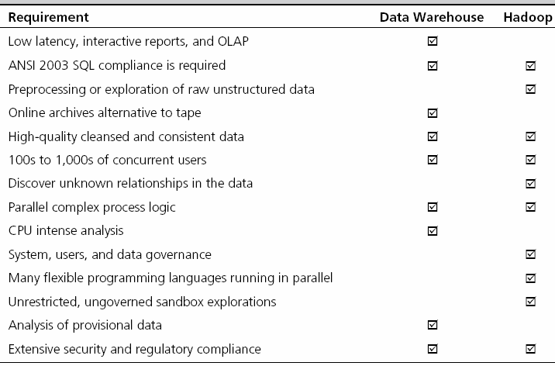
Hadoop versus Data Warehouse When to Use Which Platform

Slide 19
Coexistence of Hadoop and DW
Use Hadoop for storing and archiving multi-structured data
Use Hadoop for filtering, transforming, and/or consolidating multi-structured data
Use Hadoop to analyze large volumes of multi-structured data and publish the analytical results
Use a relational DBMS that provides MapReduce capabilities as an investigative computing platform
Use a front-end query tool to access and analyze data

Slide 20
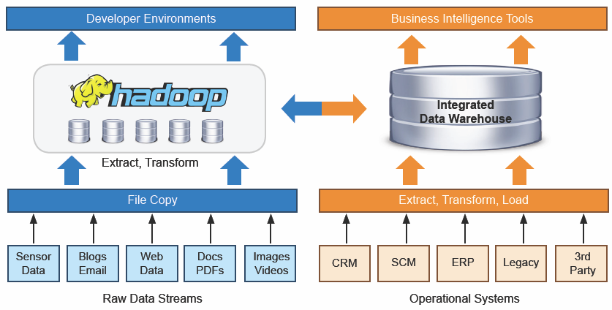
Coexistence of Hadoop and DW
Source: Teradata

Slide 21
How to Succeed with Big Data
Simplify
Coexist
Visualize
Empower
Integrate
Govern
Evangelize

Slide 22
Big Data And Stream Analytics
Data-in-motion analytics and real-time data analytics
One of the Vs in Big Data = Velocity
Analytic process of extracting actionable information from continuously flowing/streaming data
Why Stream Analytics?
It may not be feasible to store the data, or may lose its value
Stream Analytics Versus Perpetual Analytics
Critical Event Processing?

Slide 23
Stream Analytics A Use Case in Energy Industry

Slide 24
Stream Analytics Applications
e-Commerce
Telecommunication
Law Enforcement and Cyber Security
Power Industry
Financial Services
Health Services
Government

